Slide 1

Bringing the world’s creators together.

Slide 2
The Problem:
Small business owners have a hard time finding a physical space to work in or to sell their products in. These spaces are often too: expensive, large, or difficult to navigate as a single leasor.

Slide 3
Our Solution:
Provide creators with a means of finding other creators to come together, enabling them to lease spaces cheaply, efficiently, and with artists that share their creative vision.

Slide 4
Task Flows

Slide 5
Tasks Overview:
Simple task: Find a person (or more!) you would like to coalease with based on their artistic style, profile and liked spaces
Moderate task: Find a place to lease with one (or more!) coaleasors found in the simple task
Complex task: Sign a lease agreement with your fellow coaleasors (remains the same)

Slide 6
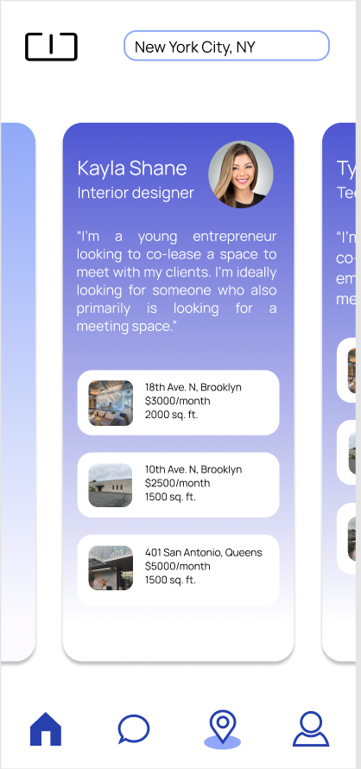
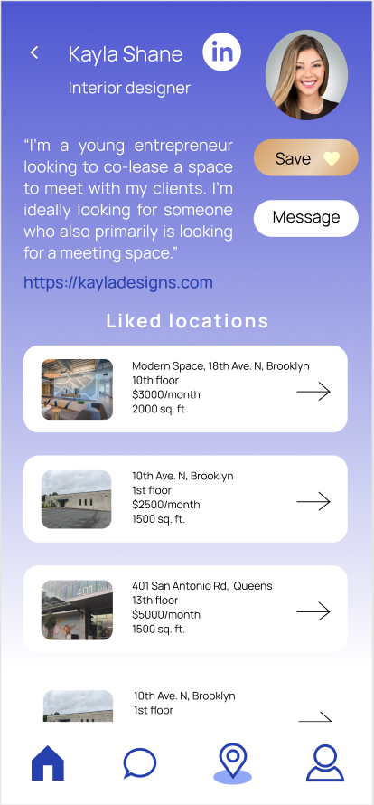
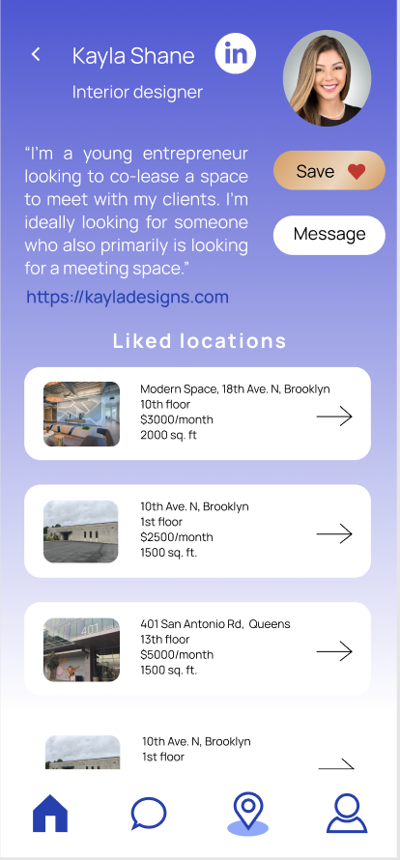
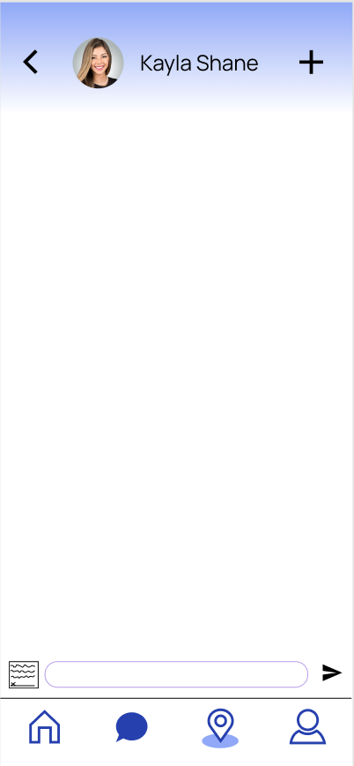
Simple Task:

Slide 7
Simple Task:
- User first navigates to homepage to scroll through other potential coaleasors
- User taps on a profile they’re interested in to see more detail about the other creator
- User “likes” the other creator to add them to their list of “liked” creators
- User presses the “message” button to open a chat window with the other coaleasor to start a conversation

Slide 8
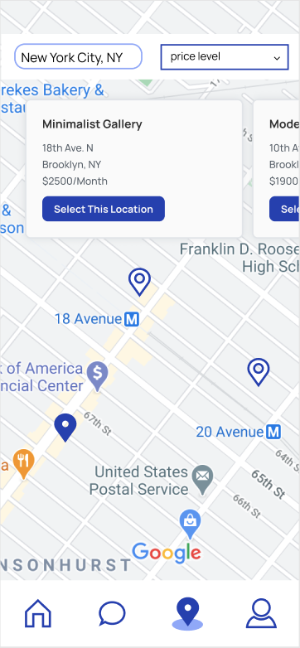
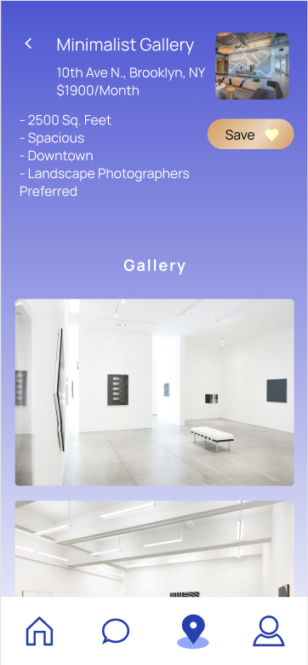
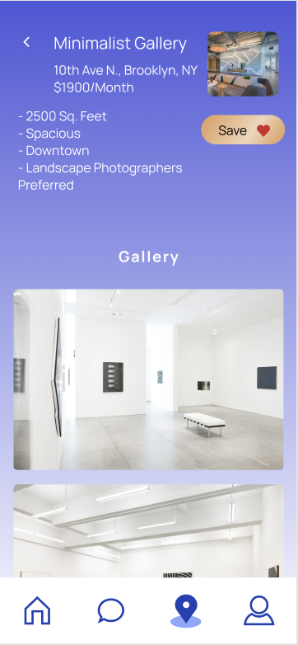
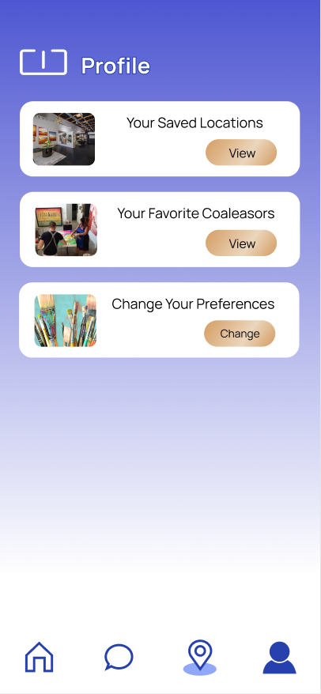
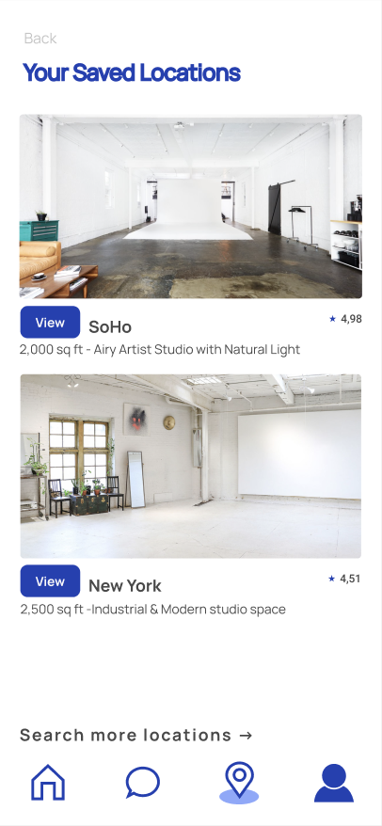
Moderate Task:

Slide 9
Moderate Task:
- User navigates to the map page to browse potential locations through a list on the top and a map on the screen (with filters at the top too)
- User clicks on a location they’re interested in to see details
- User can “like” the location to save it to their profile in their list of saved locations
- User can then explore said list to determine which place they’d like to lease by comparing places against one another

Slide 10
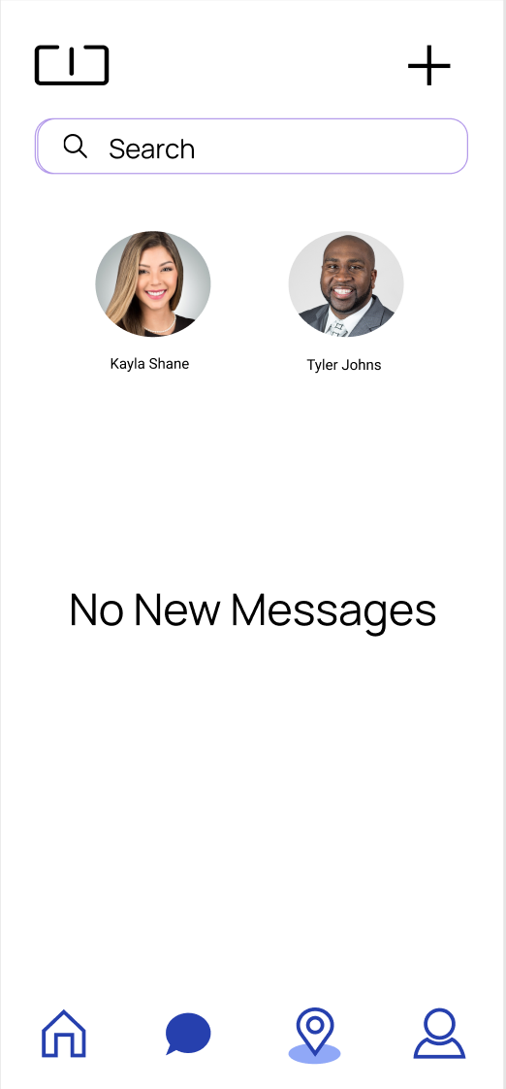
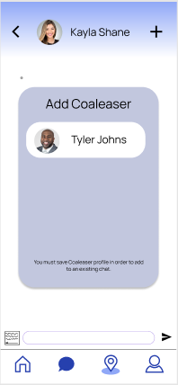
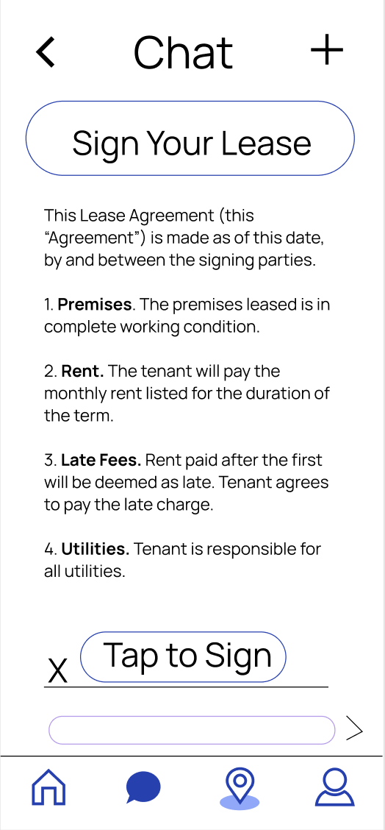
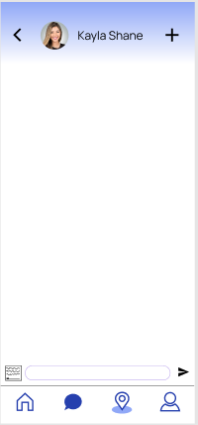
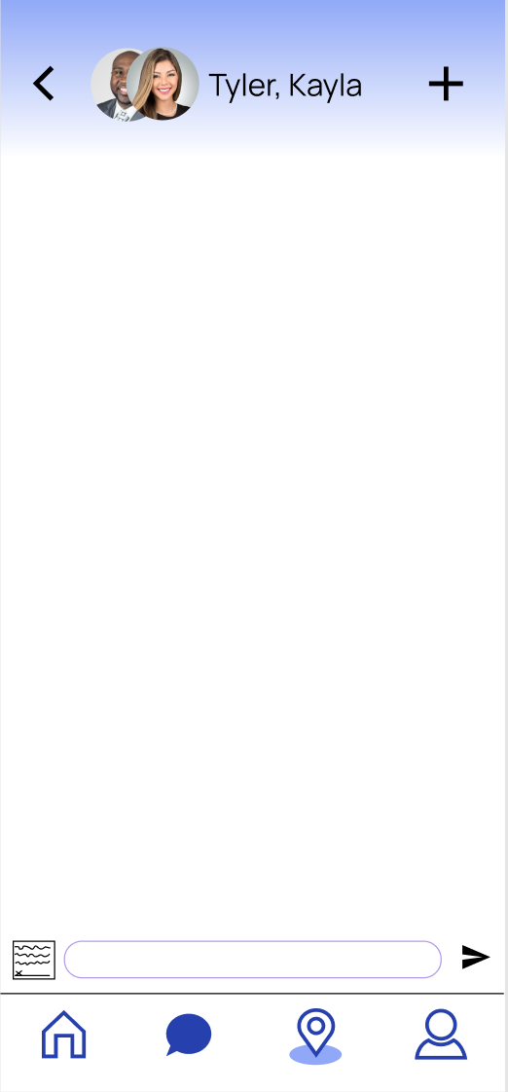
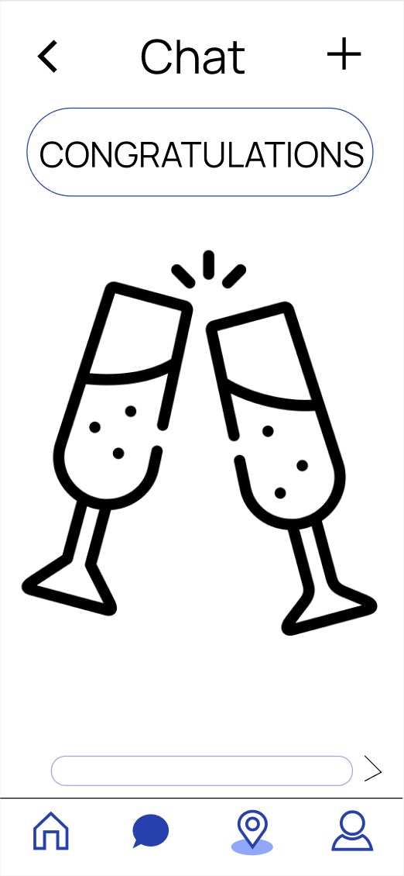
Complex Task:

Slide 11
Complex Task:
- User navigates to the chat screen to begin a chat with one of the coaleasors they’ve “liked”
- Once they begin the chat, they can add other coaleasors to the chat to coalease with multiple people
- They can propose a location to the other coaleasors in the conversation
- Once it’s been proposed, they read over the agreement and sign the lease
- They live happily ever after in their new lease!

Slide 12
UI/Design Updates

Slide 13
Updates Overview:
Updated Homepage- no longer Tinder-style swiping on people but rather a scrolling feed of profiles, enabling users to come back to profiles they skipped earlier
Updated Profile Page- now contains folders for “liked” places and coaleasors as well as a place to update your preferences for spaces to search for
Added functionality for adding multiple coaleasors to a chat- feedback that we couldn’t facilitate multiple-person coaleases

Slide 14
The person is far more important in my leasing decision than the place is. -Jesse Myers (low-fi prototype tester)

Slide 15
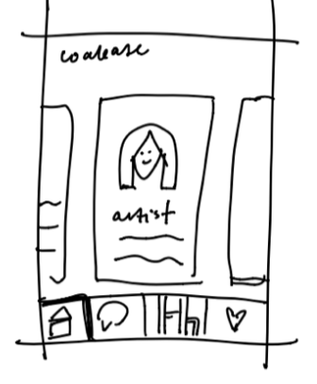
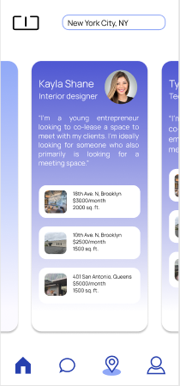
Homepage
Infinite carousel now allows for people not initially “liked” to remain on the homepage in case you want to come back to them later, no longer Tinder-style swiping

Slide 16
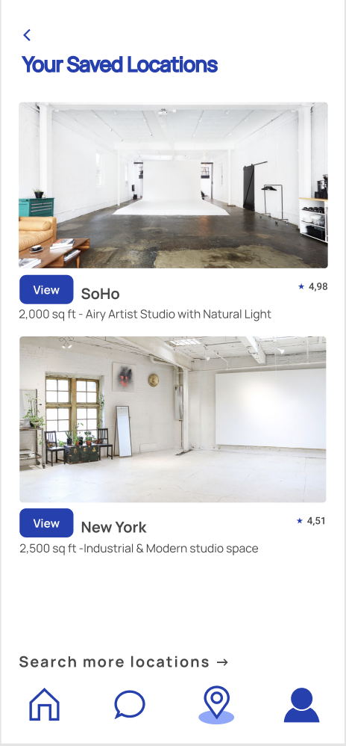
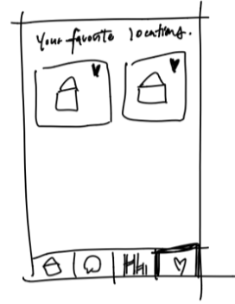
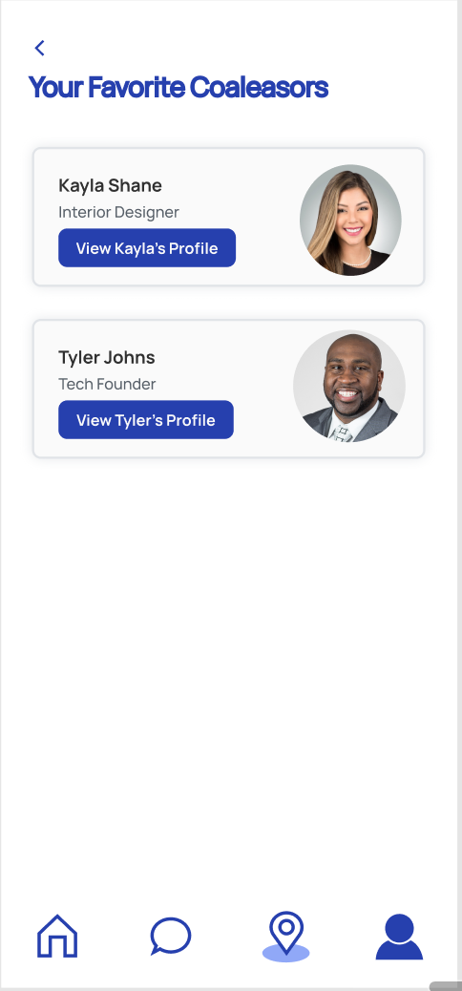
More Robust Profile
Profile now allows access to liked coaleasors, places, and information updates- far more functionality than our last iteration allowed which was just liked places

Slide 17
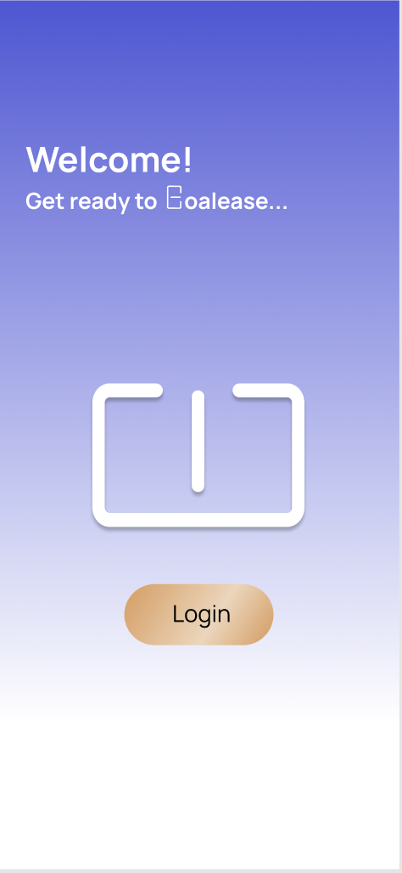
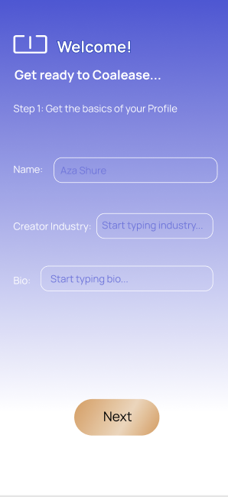
Signup Flow
Signup now takes you from profile to homepage where other coaleasors are in a carousel as opposed to navigation, which was the old flow

Slide 18
More Intuitive Chat
Allows for easier addition of multiple coaleasors to one conversation- press the button in the top right corner to add another coaleasor to the conversation!

Slide 19

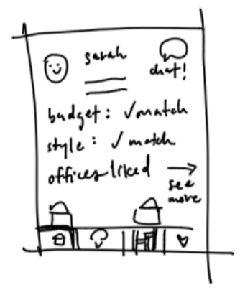
Simplified Profile Pages
Feedback that putting work on website would be a better means of showcasing style than trying to condense to a profile page here, so we added attaching personal website functionality

Slide 20
Simplified Profile Pages
Feedback that putting work on website would be a better means of showcasing style than trying to condense to a profile page here, so we added attaching personal website functionality

Slide 21
Design Tools

Slide 22
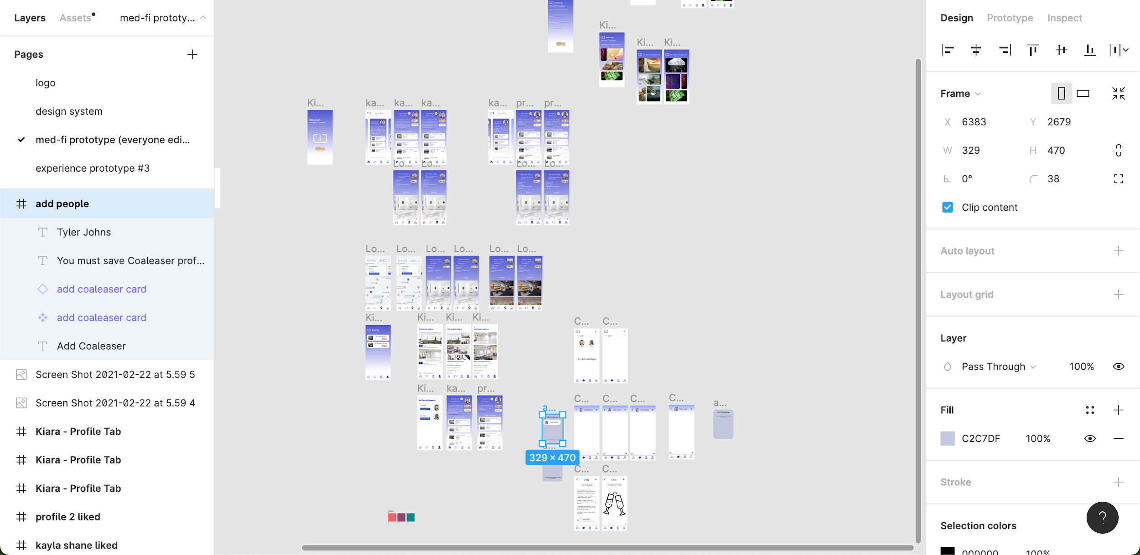
Figma
We used Figma to design our medium-fi prototype as one of our groupmembers was already relatively well-versed in its functionality

Slide 23
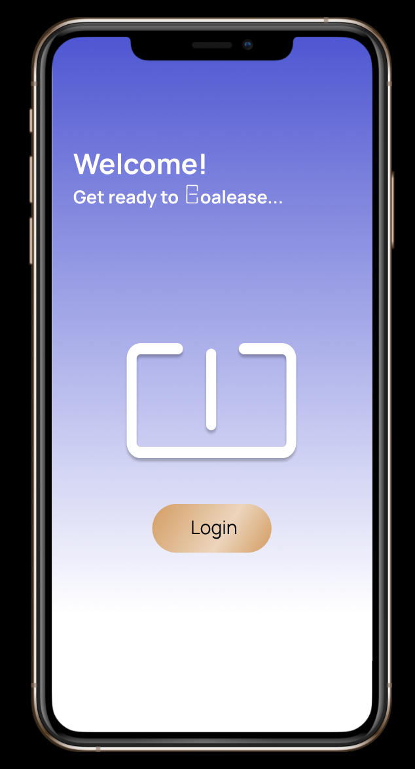

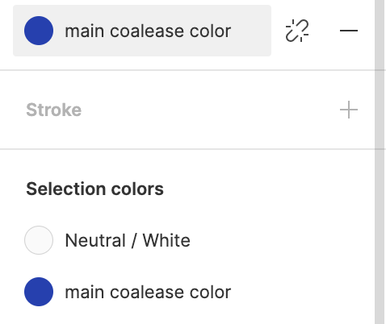
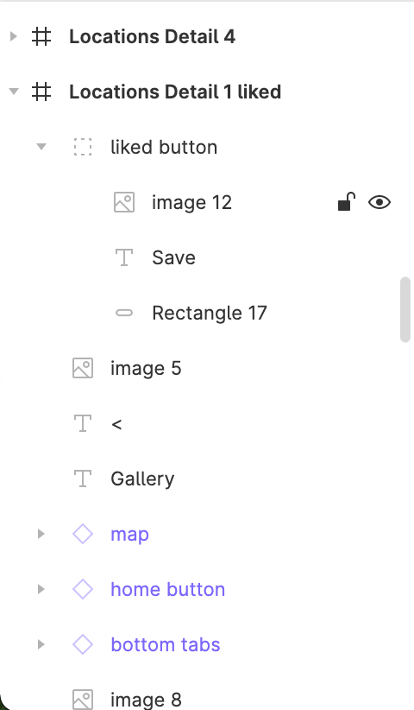
Benefits
- Familiarity
- Wiring
- Components
- Intuitive Sidebar Interface
- Common color themes

Slide 24
Drawbacks/Limitations
- No map functionality- ideally the user would be able to interact with the map screen by dragging around, but that is infeasible in anything but the google maps API
- No chat functionality- infeasible again to have screens for everything someone would potentially type (solution for next time, autosuggested messages?)
- Can get scattered- named components can get confusing and you can end up editing pieces of other screens unintentionally

Slide 25
Additional Screenshots

Slide 26
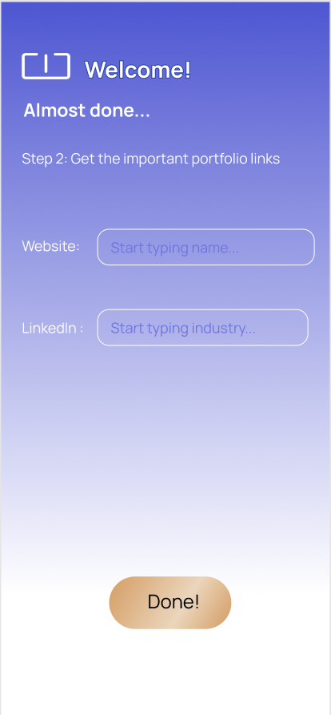
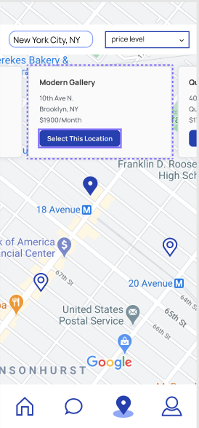
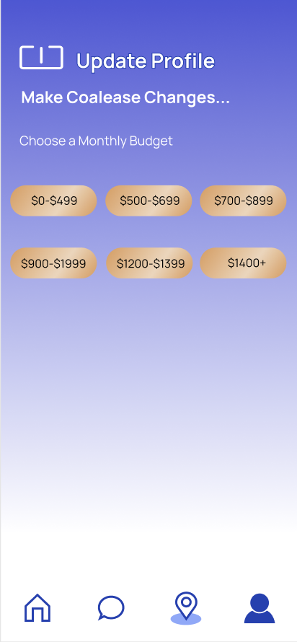
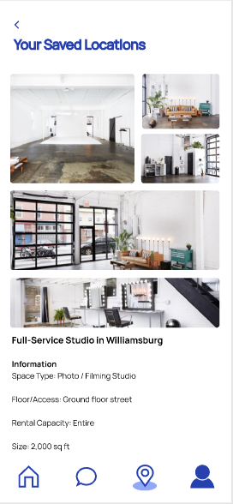

Slide 27
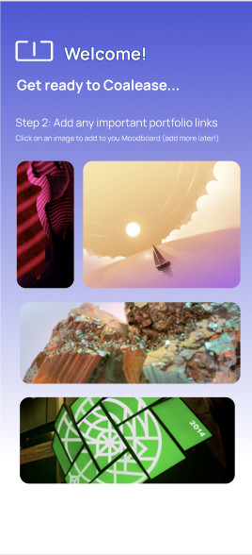
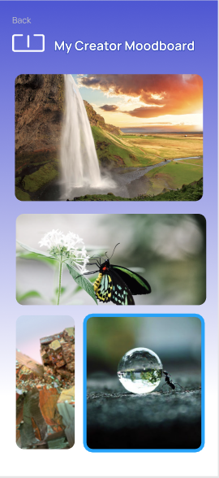
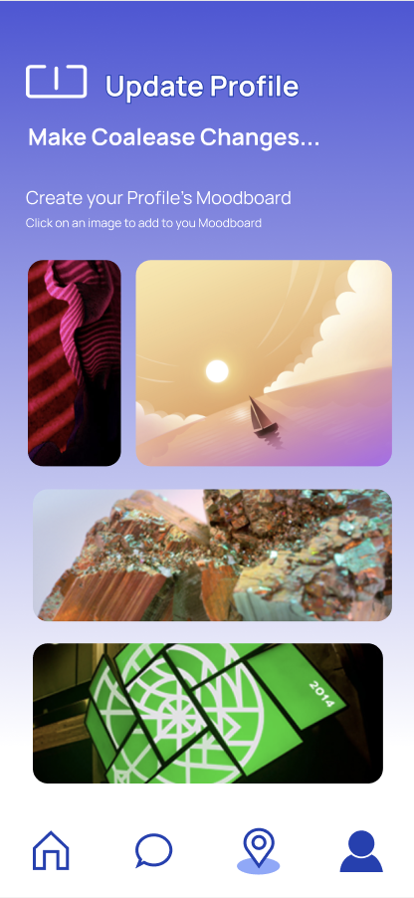
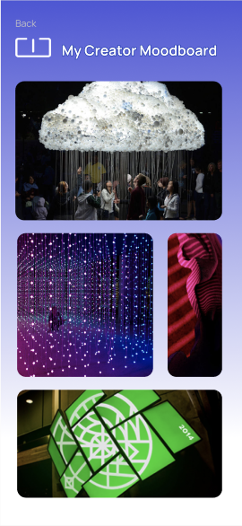
Discarded Moodboard Screenshots

